Slide 1
VOCABULARY REVIEW
Latest in-thing:
Enquiry/ɪnˈkwaɪə.ri//ˈɪn.kwə.ri/
Cultural attack /ˈkʌl.tʃər.əl/ /əˈtæk/
National identity /ˈnæʃ.ən.əl/ /aɪˈden.tə.ti/
Mutton /ˈmʌt.ən/

Slide 2
CHOOSE THE ODD WORD OUT IN EACH GROUP
1. actor audience dance director
2. choreographer conductor musician play
3. concert dancer musical show
4. act comedian entertainer magician
5. band choir orchestra singer
6. ballet clown drama opera

Slide 3

Listen to three people talking about different events. Choose the word they mention.
1. actor audience dance director
2. choreographer conductor musician play
3. concert dancer musical show
4. act comedian entertainer magician
5. band choir orchestra singer
6. ballet clown drama opera

Slide 4
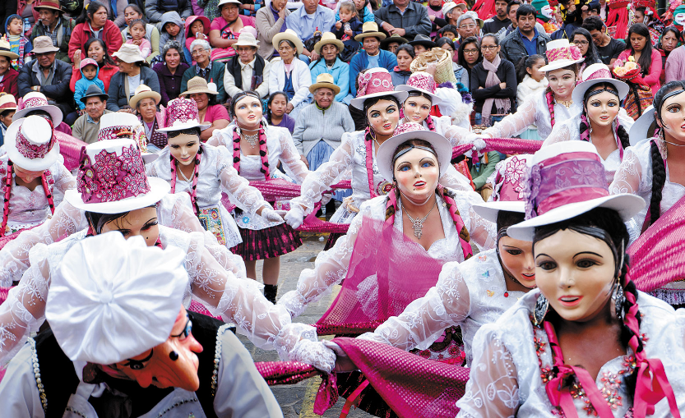
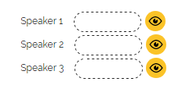
Which person is talking about the photo? What are the other two people talking about?

Slide 5
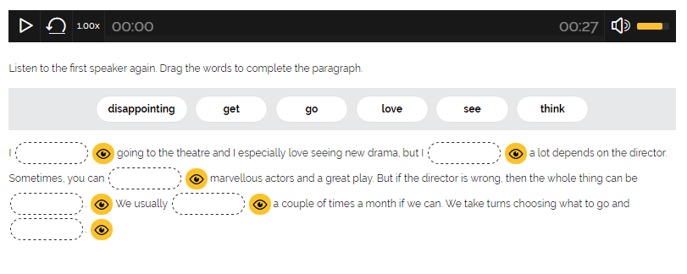

Slide 6
DISCUSSION
Work in pairs. Are you interested in the arts? Discuss these questions.
1 How often do you go to concerts, shows or the theatre?
2 What are your favourite types of events?
3 What traditional events in your country or region do you enjoy?
4 Do you like taking part in things or do you prefer being in the audience?

Slide 7
2A: MUSIC TODAY
Work in pairs. Discuss the questions. Do you like the same kind of music?
1 What’s your favourite album?
2 Do you like all the tracks on it?
3 How do you usually listen to music?

Slide 8
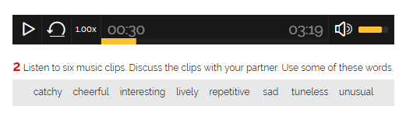

Slide 9
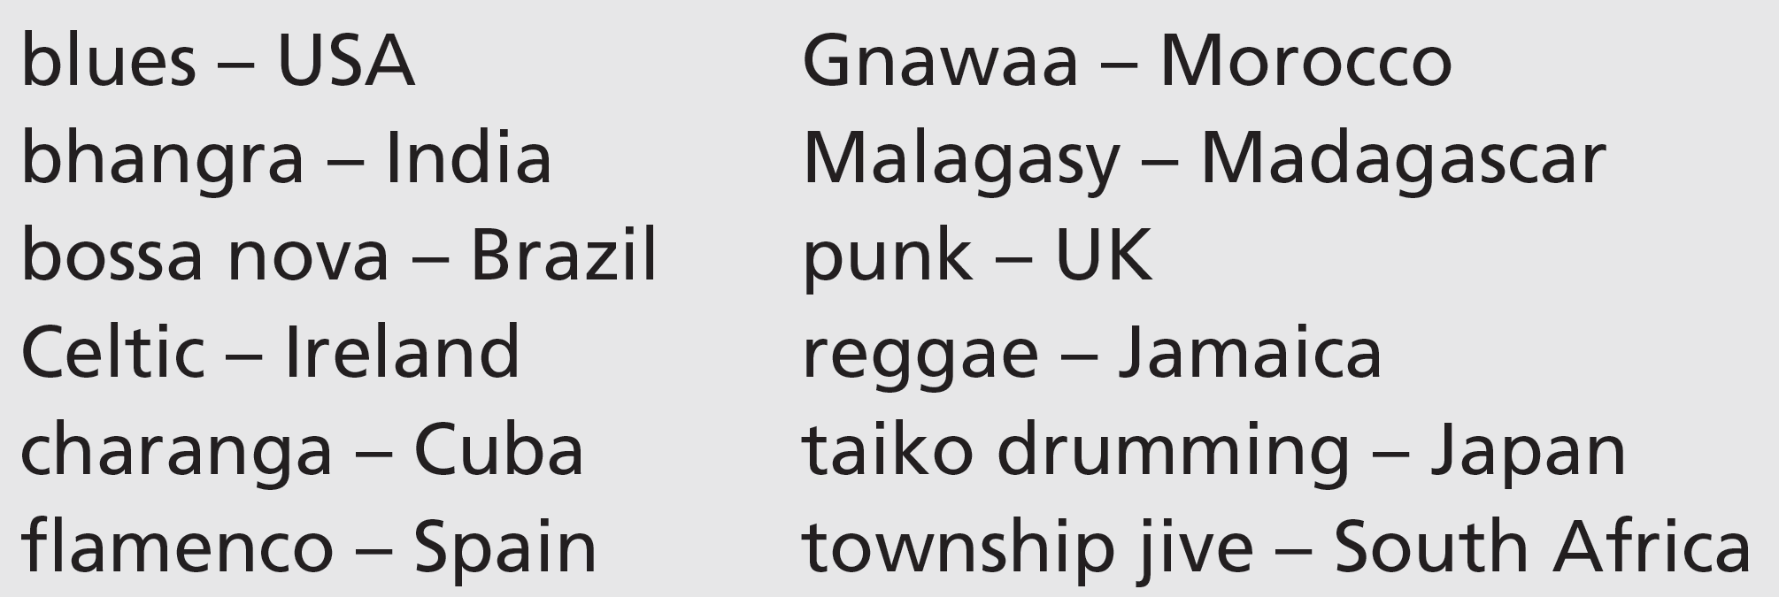
Listen again. Which country do you think each clip is from? Write the number (1–6) next to the country.

Slide 10
THE ONLINE revolution
The way we listen to and buy music has changed enormously in recent years. These days it’s hard to find a music store in your local town centre – where have they all gone? The answer, of course, is online. The number of music websites has grown incredibly quickly since internet connections became faster and cheaper. But it’s not only the way we buy music that’s different, it’s also what we buy. New vinyl records have been hard to find for years. And CD sales have fallen and MP3 sales are slowing down. In fact, thanks to musicians’ websites and other streaming websites, we can now choose the music we listen to without actually buying it. These days our choice is much wider – bands and singers release their music online direct to the listeners and so it has become much easier to discover different kinds of music from all over the world. One thing that hasn’t changed so much, however, is our love of live music. Bands still go on tour and play at festivals, giving their audiences often unforgettable experiences.

Slide 11
Reading
4 Read the article from a magazine, Music today. What’s the article about? Choose the correct option (a–c).
a the best live bands
b becoming a musician
c music and new technology
5 Read the article again. Discuss the questions.
1 Is it easy to find music stores in town centres? Why? / Why not?
2 Why are there more music websites nowadays?
3 How do we listen to music for free?
4 Why is it now easier to listen to international musicians?
2a-p. 22

Slide 12
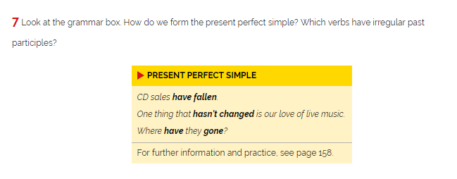
GRAMMAR

Slide 13
PRESENT PERFECT SIMPLE
Form
(+) S + have/has + PP
(-) S + have/has (not) + PP
(?) Have/has + S + PP

Slide 14
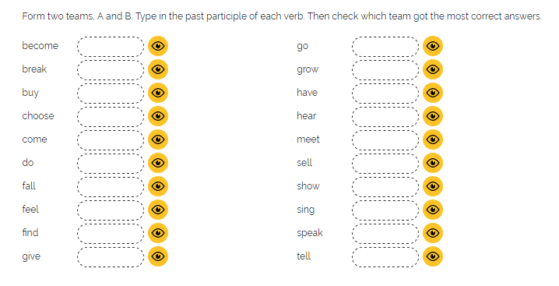

Slide 15
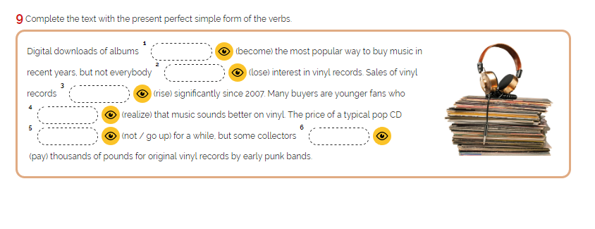

Slide 16
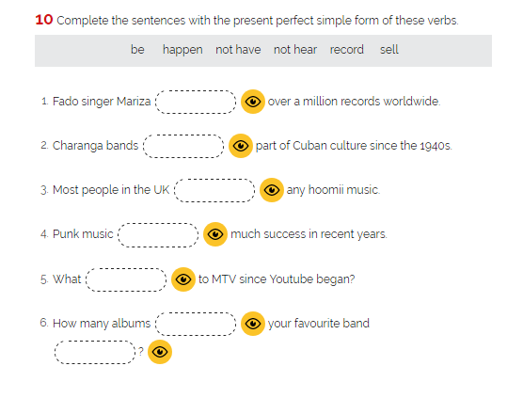

Slide 17
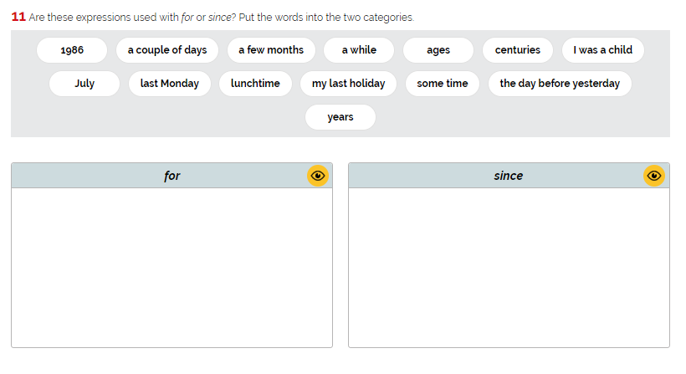

Slide 18
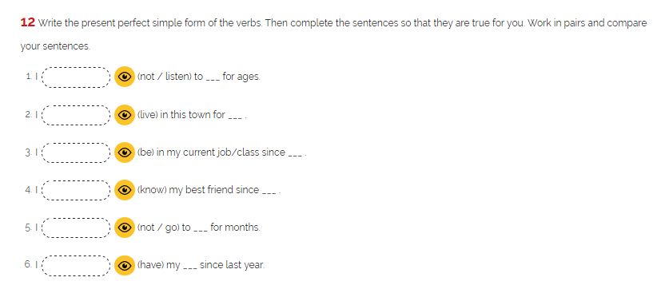

Slide 19
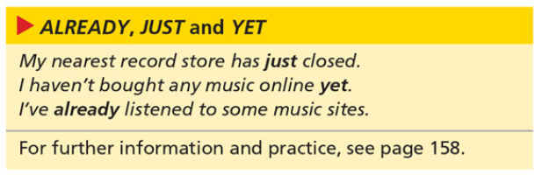
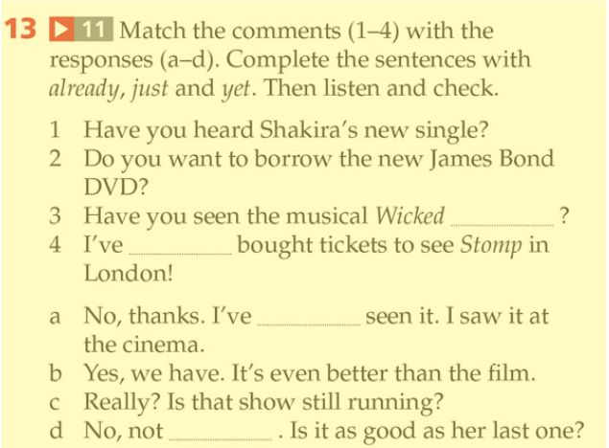

Slide 20
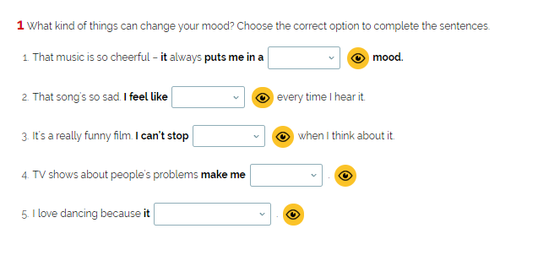
2b: LEARNING TO DANCE
bad / good?
crying / laughing?
crying / laughing?
crying / smile?
cheers me up / make me feel sad?

Slide 21
3 Work in pairs. Discuss the questions
1 What kind of dances are traditional in your region or country?
2 Have you ever been to a dance class or learned a dance?
3 Do you enjoy dancing?
4 Do you dance at special occasions? Which ones?
5 Is there a dance or kind of dance you’d like to be able to do?

Slide 22
4 Listen to a dance teacher, Bruce Daley, talking about his career. Correct the factual errors in these sentences.
1 Daley opened the studio when he started dancing professionally.
2 A lot of young kids began coming when big TV shows started.
3 Two of his older students became professionals last year.
4 Once, a very happy young man came to class.

Slide 23
Track 12
5 Listen again. Are the sentences true (T) or false (F)?
1 Daley runs dance classes for professional dancers.
2 His first students were older people.
3 Many people have found a new social life at his studio.
4 Traditional ballroom dancing has never been popular.
5 Daley has seen how dancing can change people’s moods.
6 He’s had two careers through dance.
2b-p. 25

Slide 24
6 Bruce Daley talks about the role of dancing in people’s lives. Can you think of other activities people do to:
1 make them feel young? keeping fit
2 meet people?
3 have a social life?
4 change their mood?

Slide 25
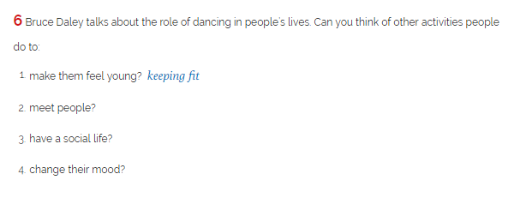

Slide 26
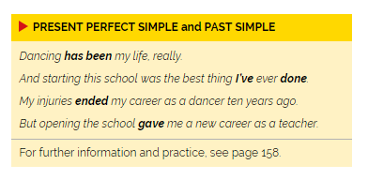
PRESENT PERFECT SIMPLE AND PRESENT SIMPLE

Slide 27
PRESENT PERFECT SIMPLE AND PAST SIMPLE
Uses:
Uses:
1. Actions started in the past and continuing in the present
Past Actions:
e.g.: I saw a ghost last Friday.
2. experience
Yesterday/Ago/Last night/
Last month/Last week/Last year
In 2003…
e.g.: They have seen that film six times
3. Actions completed in the very recent past
e.g.: I have just eaten.
Form
Form
(+) S + have/has + PP
(-) S + have/has (not) + PP
(?) Have/has + S + PP?
(+) S + was/were + S + V2/-ed + …
(-) S + wasn’t/weren’t S + didn’t + V…
(?) Was/were + S + V? Did + S + V?

Slide 28
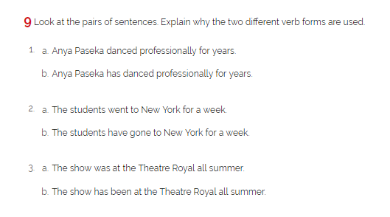

Slide 29
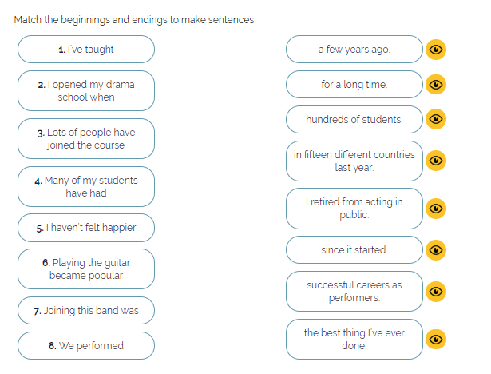

Slide 30
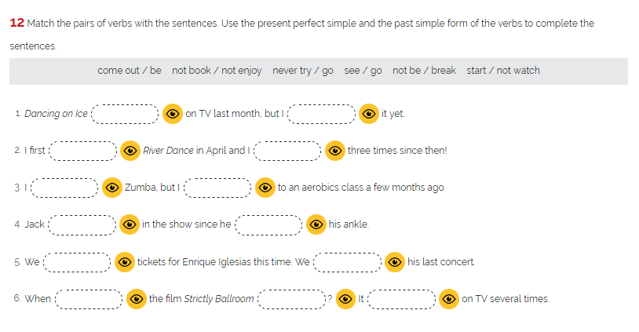

Slide 31
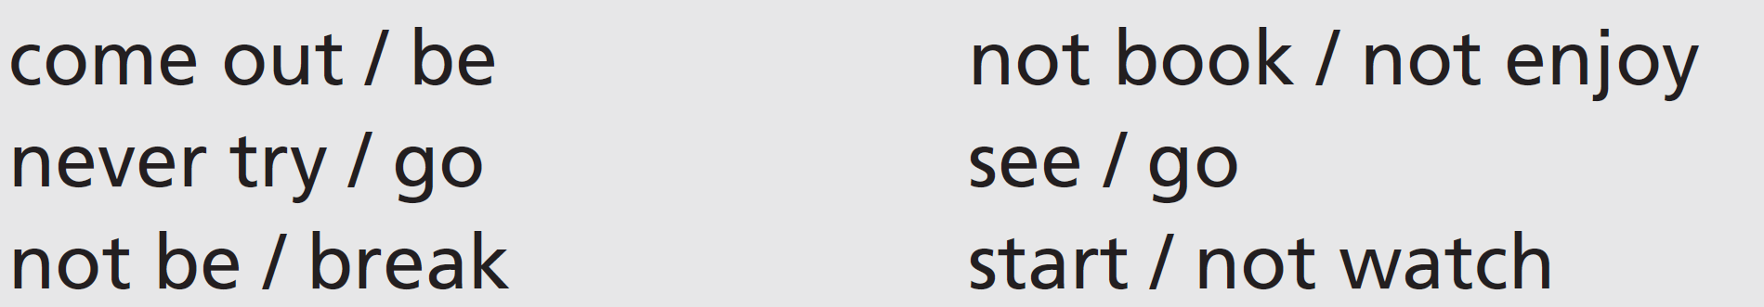
12 Match the pairs of verbs with the sentences. Use the present perfect simple and the past simple form of the verbs to complete the sentences.
1 Dancing on Ice ________________ on TV last month, but I ________________ it yet.
2 I first ________________ River Dance in April and I ________________ three times since then!
3 I ________________ Zumba, but I ________________ to an aerobics class a few months ago.
4 Jack ________________ in the show since he _______________ his ankle.
5 We ________________ tickets for Enrique Iglesias this time. We ________________ his last concert.
6 When ________________ the film Strictly Ballroom ________________? It ________________ on TV several times.
2b-p. 25

Slide 32
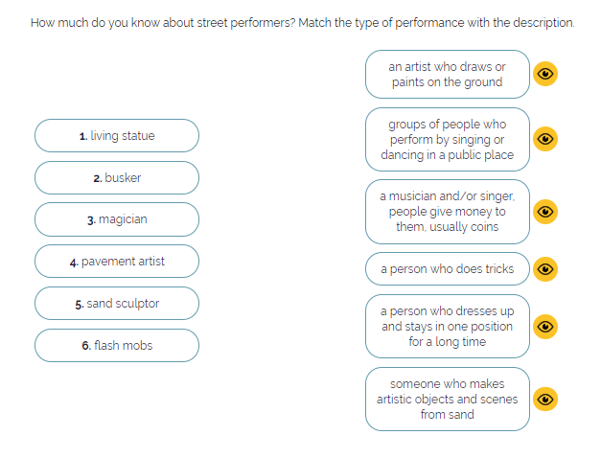
2c: LIVING STATUES

Slide 33
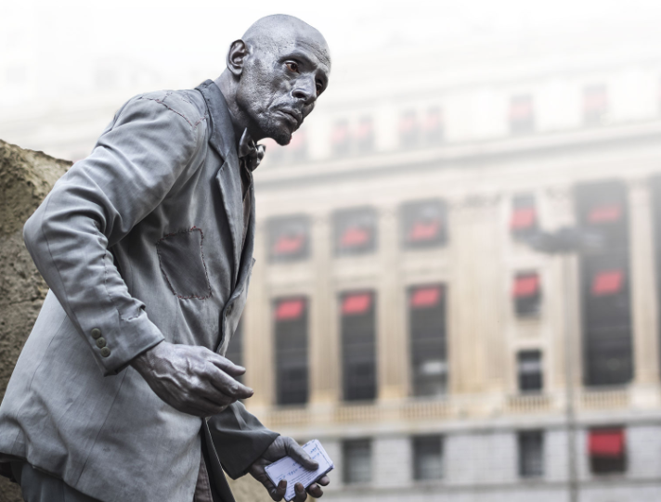
Where can you see living statue?
What it feels like to be a living statue?

Slide 34

Track 15
Go sightseeing in many cities today and among the famous buildings, street markets and other attractions, sooner or later you’ll see a special kind of display – living statues. These street performers, who are usually dressed as famous characters from history or from popular culture, have become a common sight in tourist areas of Paris, London, Barcelona and other cities. The performance involves standing completely still for long periods of time. The performers are like statues, but they are human.
2c-p. 27

Slide 35
Track 15
This kind of performance has a long history and it has existed in various forms since the sixteenth century. The French used the term tableaux vivants, which means ‘living pictures’. A group of actors stood in positions to illustrate a scene, but they didn’t speak or move during the display.
The subject of the displays was often religious or from mythology. In some places, they were part of royal occasions. In the Catalan region of Spain, tableaux vivants has been a popular tradition since the early eighteenth century. The performances are called Els Pastorets (shepherds). They take place at Christmas and show the nativity scene. Nowadays, Catalonia is also famous for its modern living statues. In fact, there are so many of them on the streets of Barcelona that the city council has decided to control the number and give out only thirty licences for fifteen locations. Local resident Joan Castells explained, ‘You can’t move past the crowds on the pavement, and most of them are not really entertaining people, they’re just begging.’ Now, each licensed artist can perform either in the morning or in the afternoon.
2c-p. 27

Slide 36

Track 15
So why do so many people want to be living statues? Joan Castells says, ‘It’s an easy way of earning money. All you need is some makeup and a costume.’ But according to one of the living statues in London’s Covent Garden, ‘Preparation takes ages – and so does getting clean at the end of the day. It’s also extremely difficult to stay completely still for long periods. I can’t even move my eyes or show that I’m breathing.’ And although it’s ‘understood’ that if you take a photo or a selfie, you leave some money, not everyone is so kind and generous. ‘Nobody gets rich doing this,’ said the living statue I spoke to in London.
Perhaps they don’t get rich, but every performer has some tricks to encourage people to give them money. Every time a tourist throws them a coin, they react with a quick, small movement. Perhaps they wave, or turn their head or reach to touch the person. The statue comes to life for just a moment, entertaining the crowd and rewarding the payment. And maybe giving the tired and aching performer a chance to move into a new, more comfortable position.
2c-p. 27

Slide 37
4 Work in pairs. Read the article again and discuss these questions.
1 Who is the main audience for this kind of performance?
2 What are the main differences between living statues and tableaux vivants?
3 What makes a living statue successful?
2c-p. 26

Slide 38

5 Find these words in the article. Look at how the words are used and try to guess their meaning. Then replace the words in bold in the sentences (1–6) with these words.
1 An actor usually wears a set of special clothes on stage.
2 Don’t walk in the road – get on the path.
3 Sadly, we see a lot of people who are asking people for money in the street nowadays.
4 The audience was shouting at him, but he didn’t say or do anything in response!
5 The pictures in the book show what the story is about really well.
6 We spoke to a person who lives in this area about the traffic problems.
2c-p. 26

Slide 39

Word focus kind
8 Read the two examples from the article. Say if kind is an adjective or a noun.
1 … you’ll see a special kind of display …
2 … not everyone is so kind and generous …
9 Complete the sentences with these expressions.
1 Flowers! _____________________!
2 Grunge is _____________________ rock music that started in the 1980s in the USA.
3 I love going to exhibitions and _____________________.
4 It’s _____________________ you to lend me the money.
5 My aunt always gives me the perfect present. She’s such a _____________________ person.
2c-p. 26

Slide 40
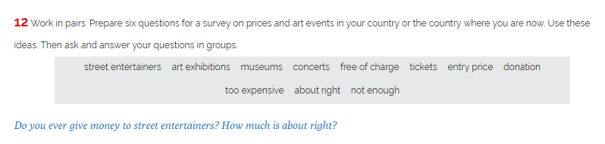
SPEAKING

